Slide 1
100 Days code challenge
DAY 3
NAME: PRIYANKA GUPTA
REG NO.: 22MCA10082

Slide 2
PROBLEM
Given an array, rotate the array to the right by k steps, where k is non-negative.
Example 1:
Input: nums = [1,2,3,4,5,6,7], k = 3 Output: [5,6,7,1,2,3,4] Explanation: rotate 1 steps to the right: [7,1,2,3,4,5,6] rotate 2 steps to the right: [6,7,1,2,3,4,5] rotate 3 steps to the right: [5,6,7,1,2,3,4]
Link: https://leetcode.com/problems/rotate-array/

Slide 3
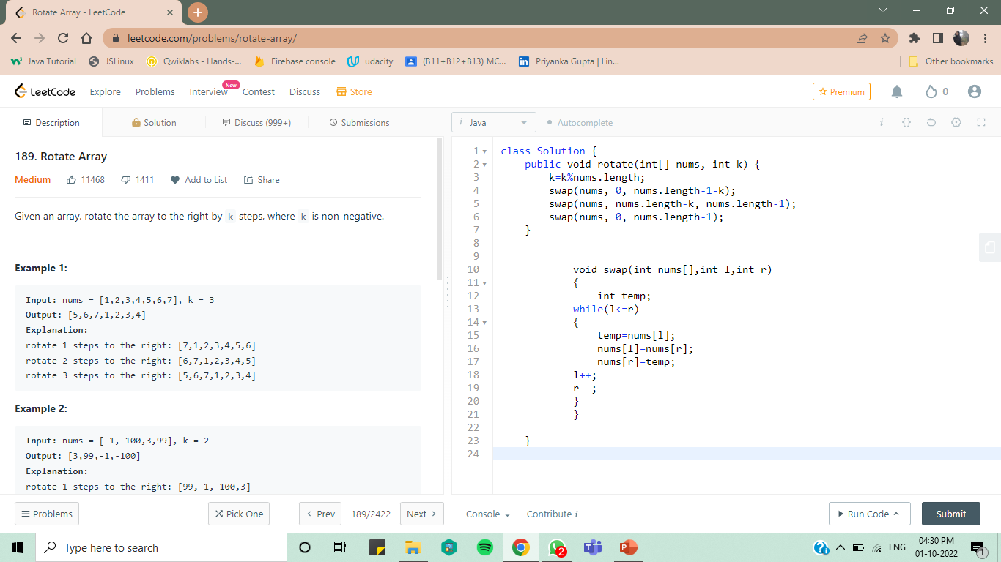
SOLUTION

Slide 4
LEARNING
In this problem we have rotated the array by swapping .
First we need to check whether the number of times we need to rotate is less than the length of array.
swap(nums, 0, nums.length-1-k);
swap(nums, nums.length-k, nums.length-1);
swap(nums, 0, nums.length-1);
These will call function swap for 3 times until the array is roated.

Slide 5
SOME INTERVIEW QUESTIONS RELATED TO THIS PROBLEM
1.What are the considerations to be made in case of loops in Java ?
It shouldn't result in infinite loop. Please make sure that you have a condition that will terminate the loop and that condition should be reached.
Make sure to use the break statement if you aspire to only look for something. Not using break will unnecessarily execute it till the end of for loop in some cases.
Similarly use continue to execute the loop with next iteration and bypass the rest of the code block if required.
2. What is the difference between a break statement and a continue statement?
Break statement results in the termination of the statement to which it applies (switch, for, do, or while). A continue statement is used to end the current loop iteration and return control to the loop statement.

Slide 6
3. What Is an enhanced for Loop?
Is another syntax of the for statement designed to iterate through all the elements of a collection, array, enum or any object implementing the Iterable interface
for (String aString : arrayOfStrings) { // ... }
4. What Is the Difference Between an Unlabeled and a Labeled break Statement?
An unlabeled break statement terminates the innermost switch, for, while or do-while statement, whereas a labeled break ends the execution of an outer statement.
5. How Can You Exit Anticipatedly From a Loop?
Using the break statement, we can terminate the execution of a loop immediately.

